Slide 1
IPsec VPN site to site
By Christopher Ditto, Carlos Gerez, and Mark Riley Slik

Slide 2
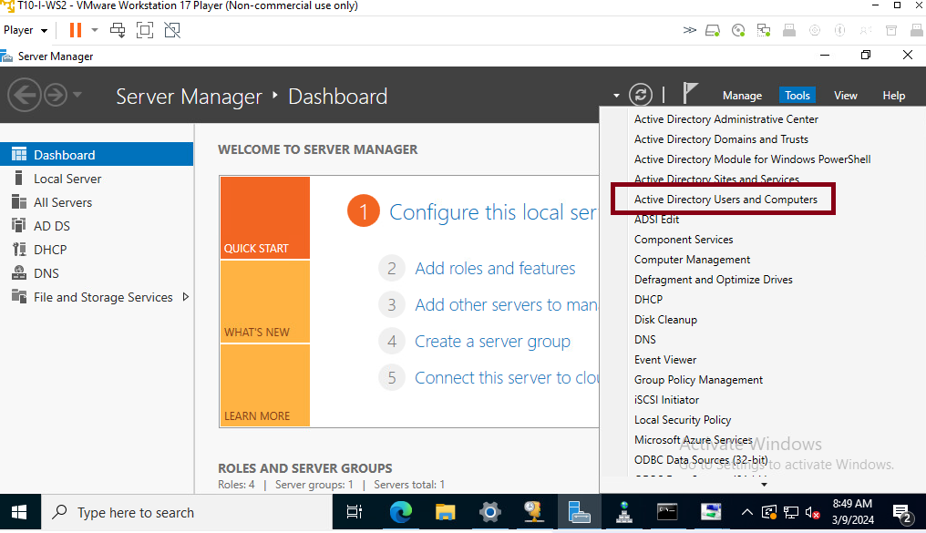
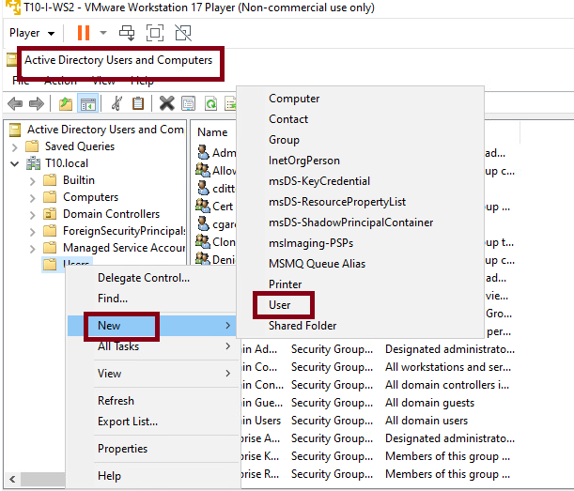
Create a user for the Team 15 in Active Directory
Since we had created a domain with a domain controller, we manage the new users centrally from Users and Computers in Active Directory

Slide 3
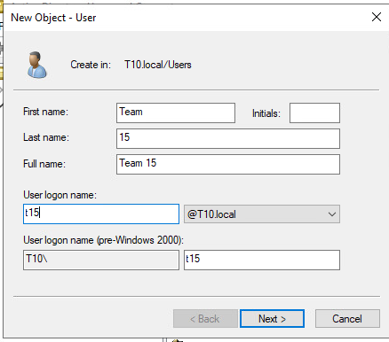
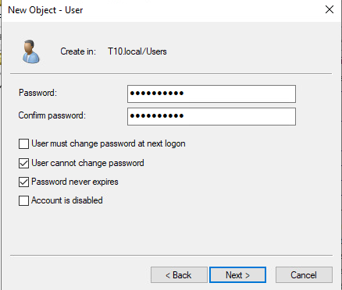
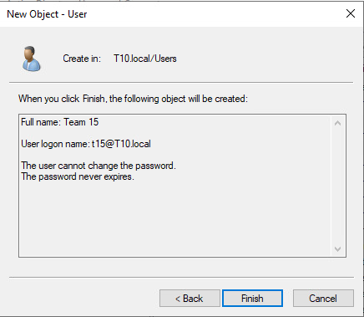
Create a user for the Team 15 in Active Directory
Then we create a new user that can be used on any endpoint on the DMZ zone.
This new user at logon will be identified as t15@T10.local

Slide 4
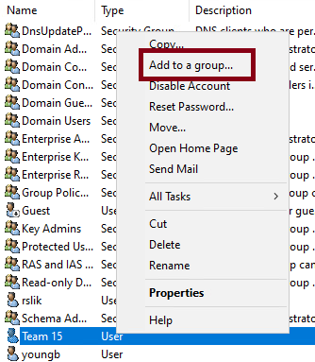
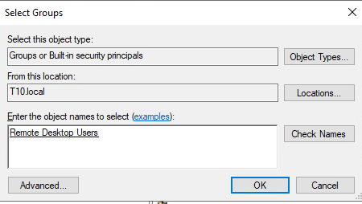
Create a user for the Team 15 in Active Directory
We add the new user to the Remote Desktop Users. The new username is
Team 15.

Slide 5
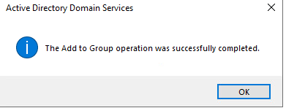
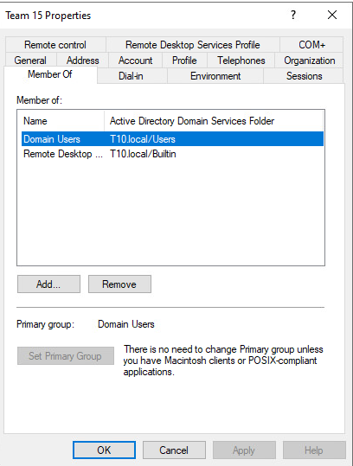
Create a user for the Team 15 in Active Directory
This is how the final team 15 properties should look.

Slide 6
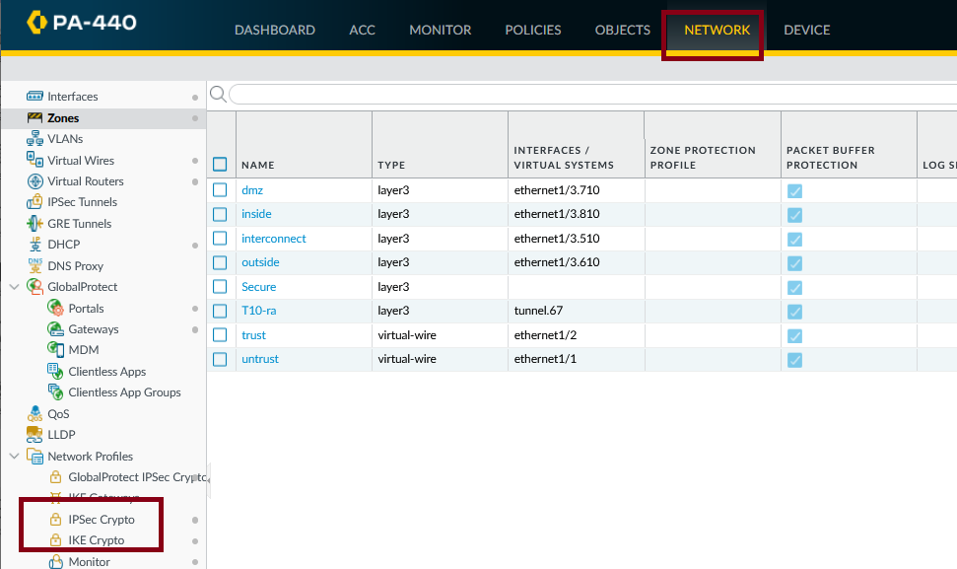
Configuration of IPSec on Palo Alto Firewall
Create an IKE gateway with default values for the tunnel. We see that we have in the side menu, default values for cryptographic management that we will use.

Slide 7
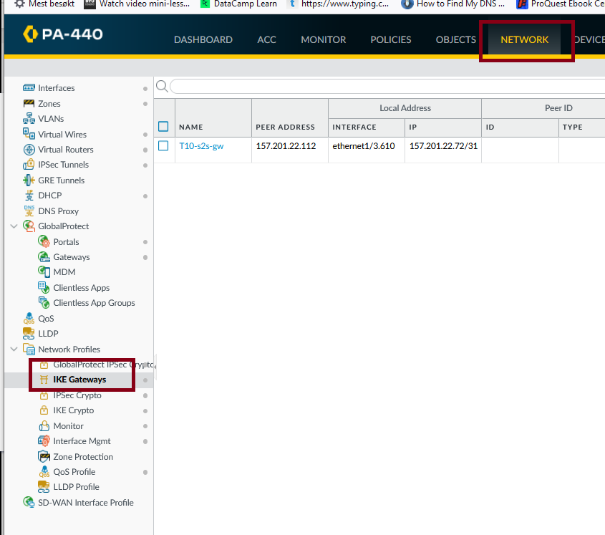
Configuration of IPSec on Palo Alto Firewall
Create an IKE gateway. Start in the IKE gateways tab on the side menu.

Slide 8
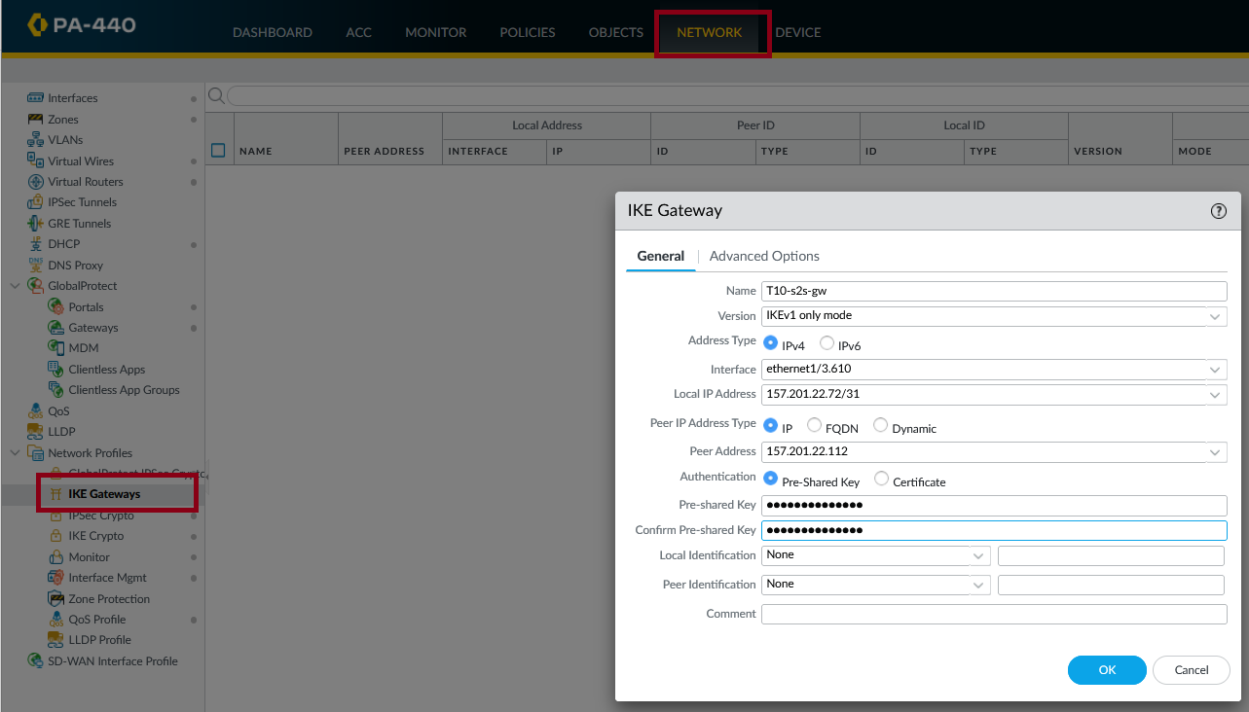
Configuration of IPSec on Palo Alto Firewall
Create an IKE gateway, give a name, leave the default version, and choose the 3.600 outside interface of your team. Local Ip address is the outside address of our team. Peer address is the other team extern ip address. The preshared Key is the password we agreed between the teams.

Slide 9
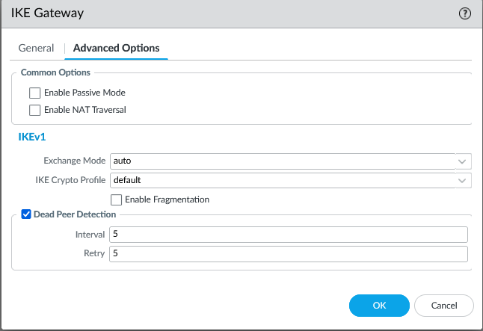
Configuration of IPSec on Palo Alto Firewall
In advance options left the defaults values.
Your final Ike Gateway should look the one in this picture.

Slide 10
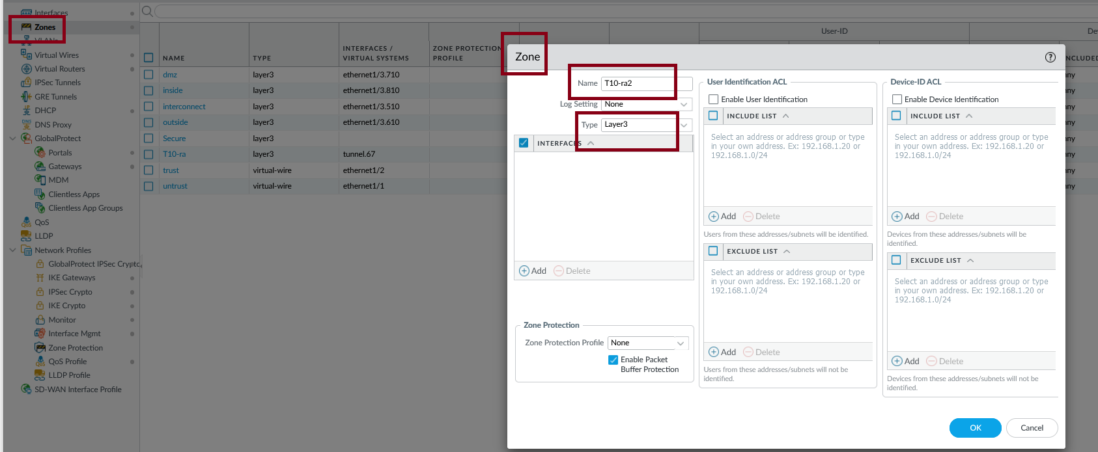
Configuration of IPSec on Palo Alto Firewall
Add a new layer 3 zone.
On Network choose Zones and add a new layer 3 zone.
Give it a name and choose Layer 3 in Type.

Slide 11
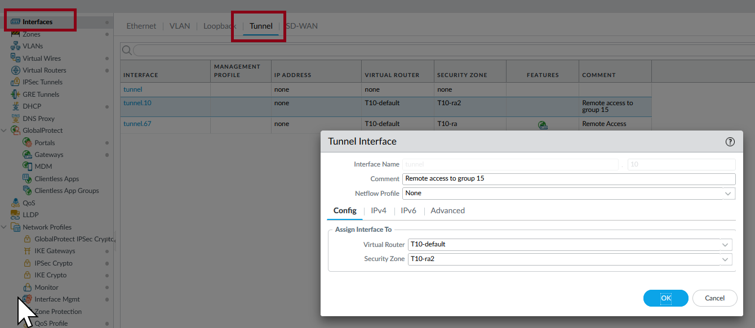
Configuration of IPSec on Palo Alto Firewall
Create a new interface tunnel.
Go to Network and choose Interfaces, then Tunnel to create a new tunnel.
Give it a name, use the default virtual router and add the newly created zone.

Slide 12
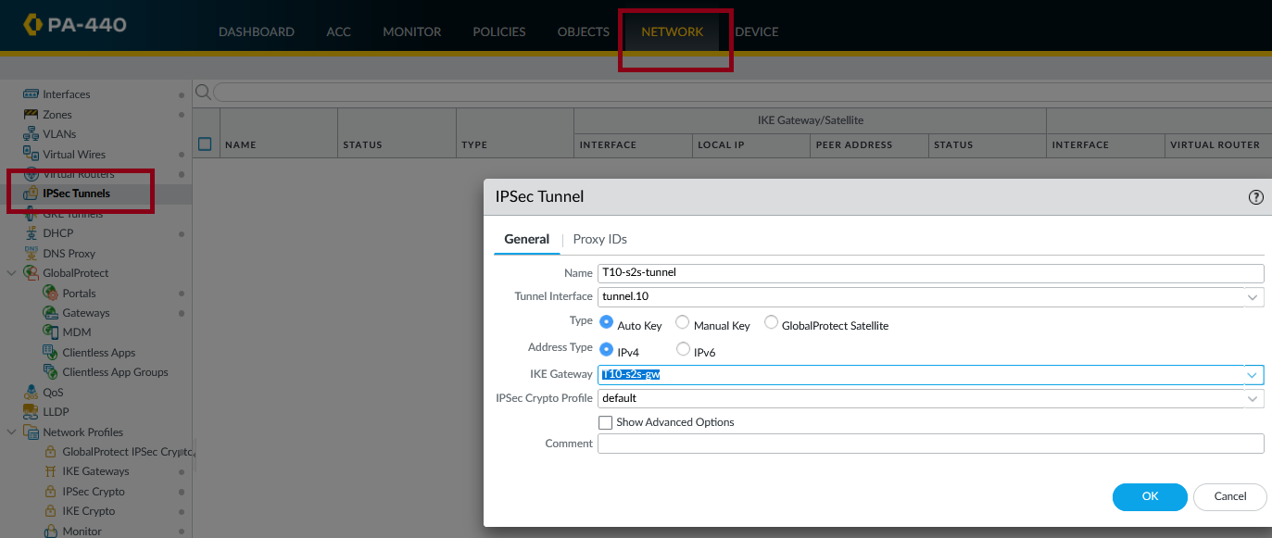
Configuration of IPSec on Palo Alto Firewall
Create an ipsec tunnel . On Network choose IPSec Tunnels and add the information, name tunnel interface already created, and IKE Gateway also previously created.

Slide 13
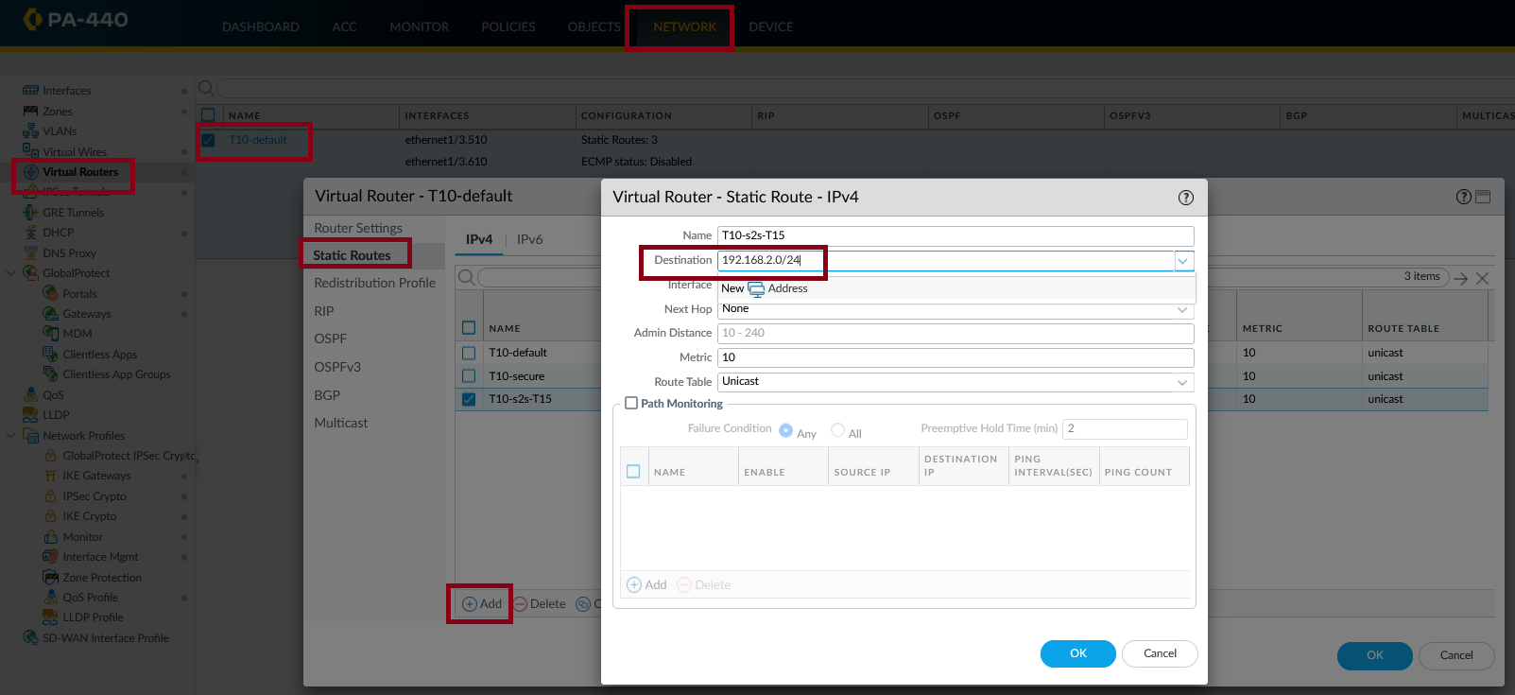
From here on we need to change the addresses with 10.1.1.0 to the range on team 15 DMZ.
Create a static route on the router. Go to Network, Virtual Routers and choose the default router, to add a new Virtual Router-Static Route. Give it a name, You will need the ip range of the DMZ zone of the other team for the destination, add the tunnel interface created before and in next hop none.

Slide 14
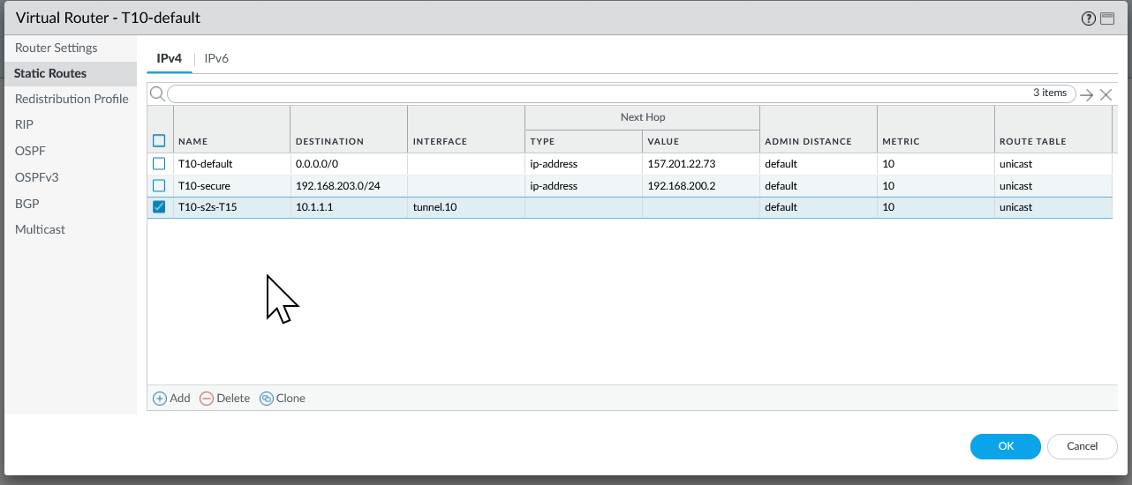
Configuration of IPSec on Palo Alto Firewall
The final static route should look like this.

Slide 15
Configuration of IPSec on Palo Alto Firewall
Create 2 new rules to allow traffic incoming and outgoing on the zones already created. The second screenshot shows the tunnel ready for testing, you can see this on IPSec Tunnels under Network.

Slide 16
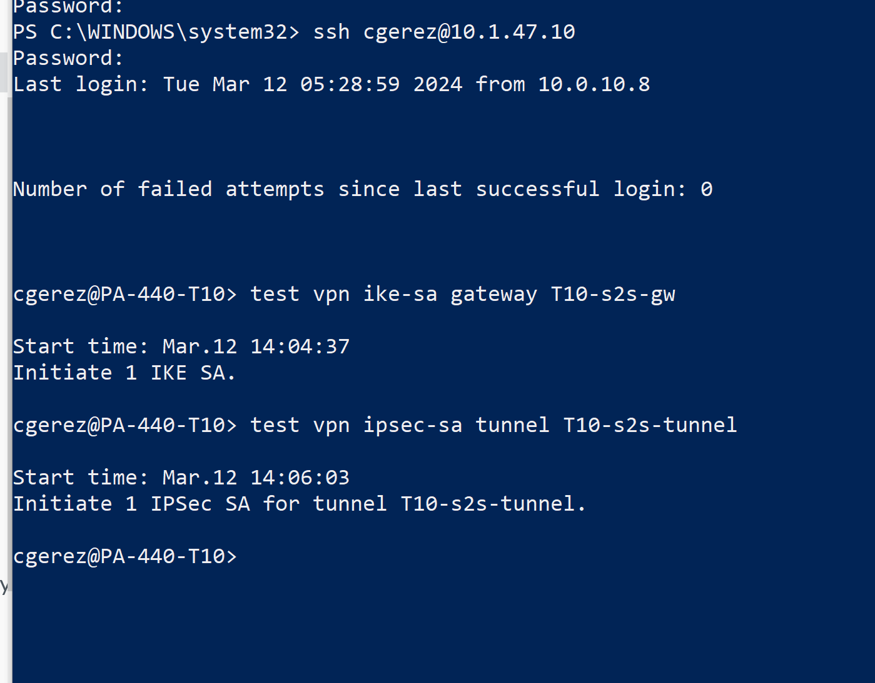
Start the connections from command line.
Access your router from your command line at home when you have the vpn connection up to test and start the tunnels. This test will bring up the connections.

Slide 17
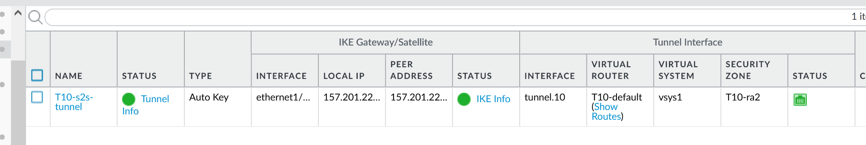
Check the status of the tunnel.
Go to Network, IPSec Tunnel and look at the connections. Green means they are up.

Slide 18
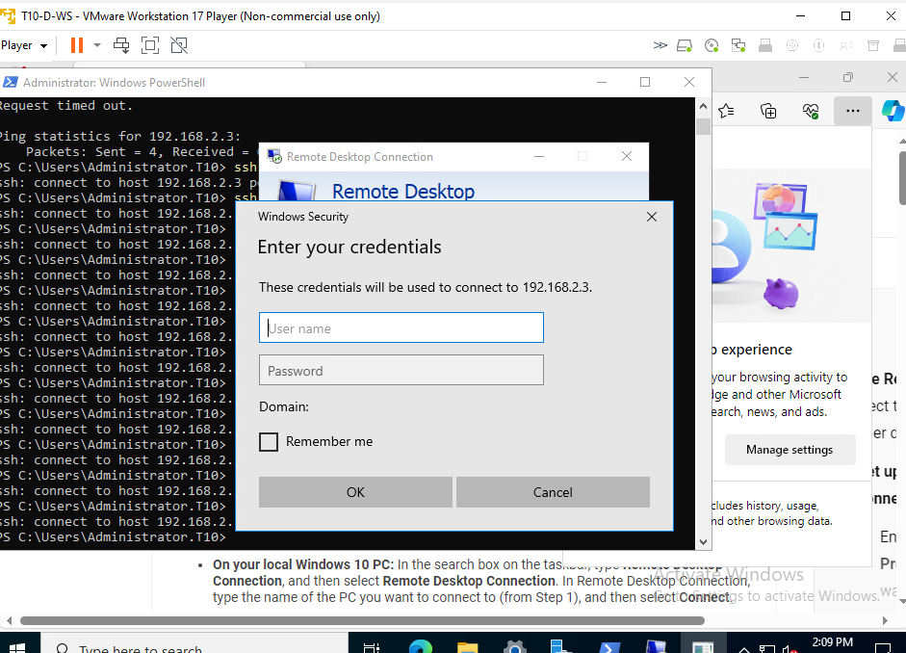
Testing the tunnel with ssh and RDP
Remote desktop from Team 10 DMZ zone towards Team 15 windows machine on DMZ zone.

Slide 19
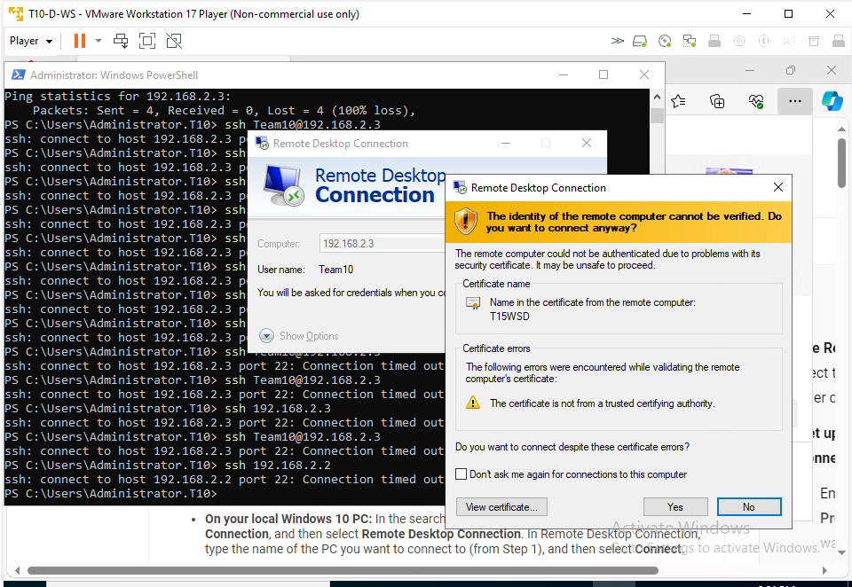
Testing the tunnel with ssh and RDP
Remote desktop from Team 10 DMZ zone towards Team 15 windows machine on DMZ zone.

Slide 20
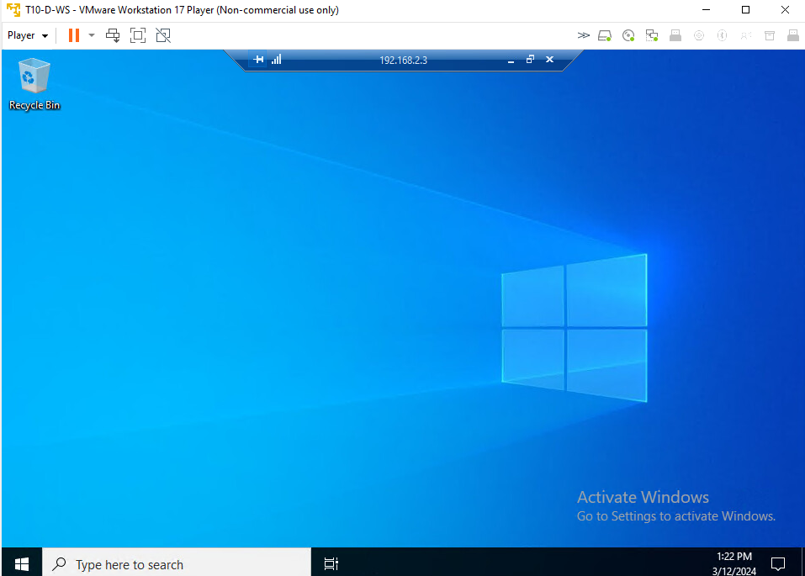
Testing the tunnel with ssh and RDP
Remote desktop from Team 10 DMZ zone towards Team 15 windows machine on DMZ zone.

Slide 21
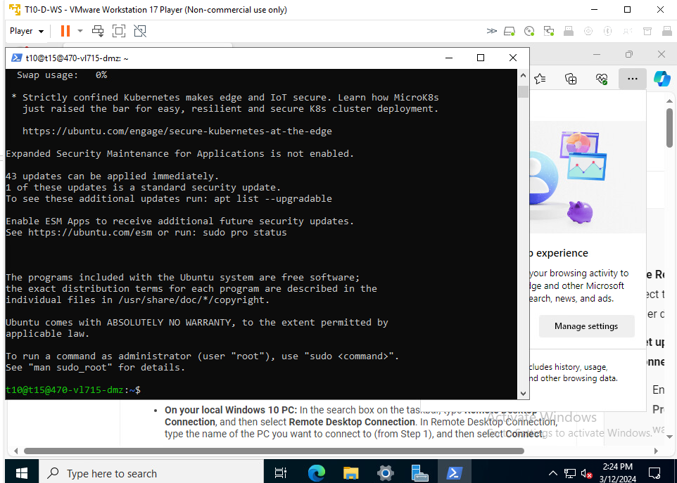
Testing the tunnel with ssh and RDP
SSH from Team 10 DMZ zone Windows machine towards Team 15 Linux machine on DMZ zone.

Slide 22
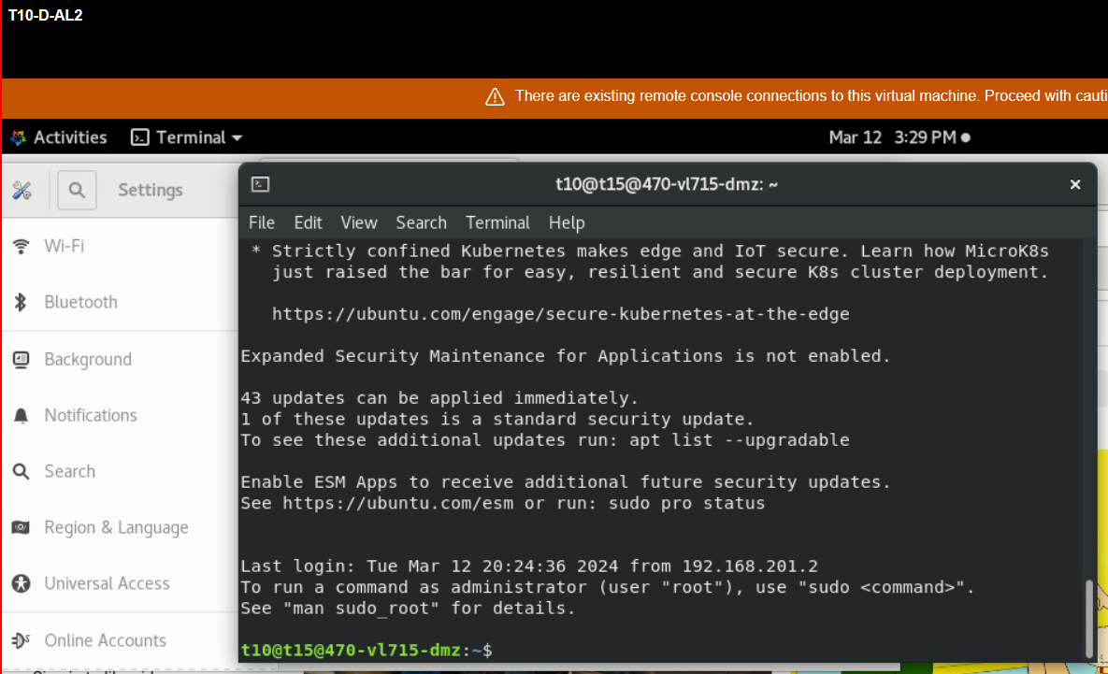
Testing the tunnel with ssh and RDP
SSH from Team 10 DMZ zone Linux machine towards Team 15 Linux machine on DMZ zone.

